Slide 1
ADC TM4C123GH6PM
The TM4C123GH6PM microcontroller contains two identical Analog-to-Digital Converter modules.
ADC0 and ADC1
12-bit conversion precision and share the same 12 analog input channels.
Each ADC module operates independently and can therefore execute different sample sequences, sample any of the analog input channels at any time, and generate different interrupts and triggers.

Slide 2
Features
12 shared analogue input channels
12-bit precision ADC
Single-ended and differential-input configurations
On-chip internal temperature sensor
Maximum sample rate of one million samples/second (MSPS)
Optional phase shift in sample time programmable
Four programmable sample conversion sequencers from one to eight entries long, with corresponding conversion result FIFOs
Five flexible trigger controls
Software Trigger Controller (default)
Timers
Analog Comparators
PWM
GPIO
Hardware averaging of up to 64 samples
2 Analog Comparators

Slide 3
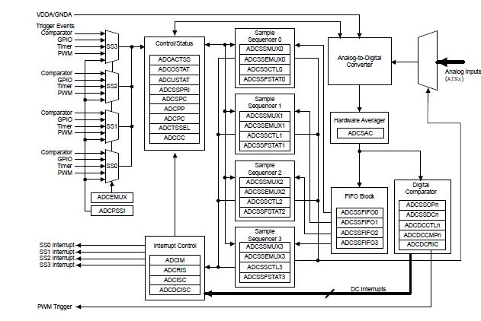
Block Diagram

Slide 4
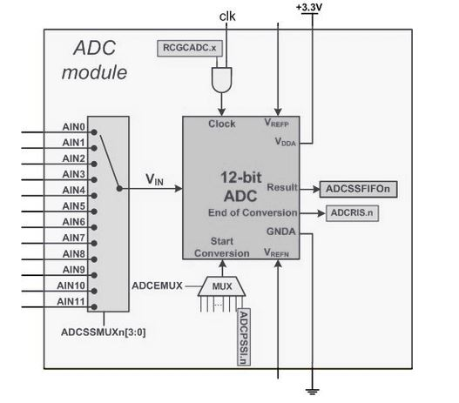
Simplified block diagram

Slide 5
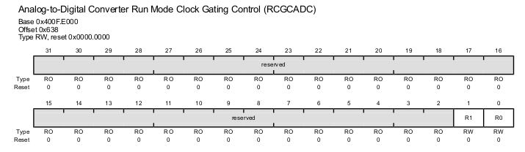
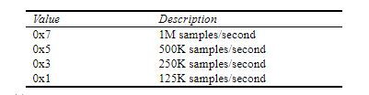
Enabling Clock to ADC

Slide 6
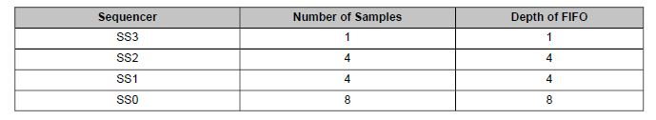
Sample Sequencer
The sampling control and data capture is handled by the sample sequencers
All of the sequencersare identical in implementation except for the number of samples that can be captured and the depthof the FIFO.
Sample sequencers are enabled by setting the respective ASENn bit in the ADC Active SampleSequencer (ADCACTSS) register and should be configured before being enabled

Slide 7
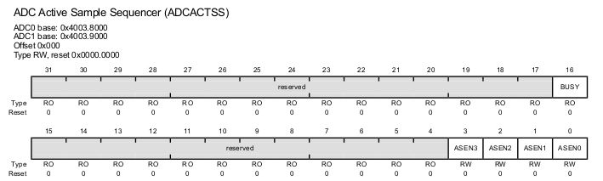
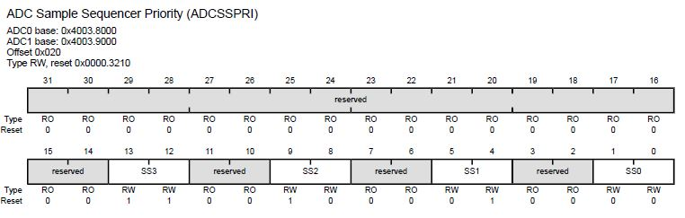
Continue..

Slide 8
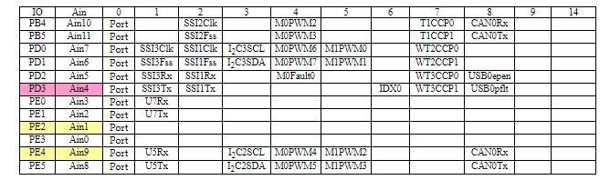
Choosing V_{in} input channel
The channel selection is done through the ADCSSMUXn (n=0, 1, 2, 3) registers. For the SS3, the ADCSSMUX3 is used. Since SS3 only handles single conversion, bits 3 – 0 are used to specify the analog channel to be converted

Slide 9
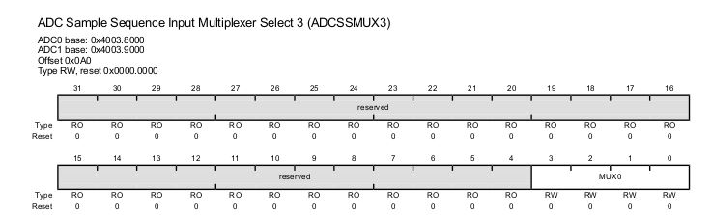
Continue..

Slide 10
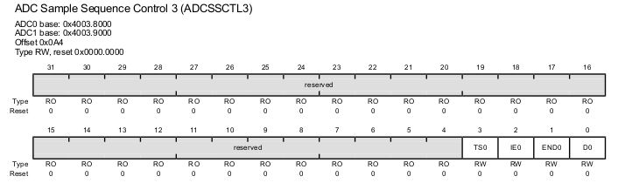
ADC Sample Sequence Control

Slide 11
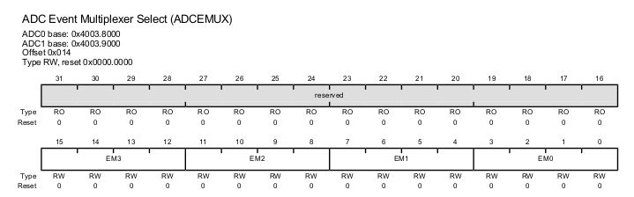
Start Conversion trigger options
Timer,
PWM,
Analog Comparator,
External signal from GPIO,
Software
The selection of Trigger for SS3 is done via the bits 15-12 of ADCEMUX register

Slide 12
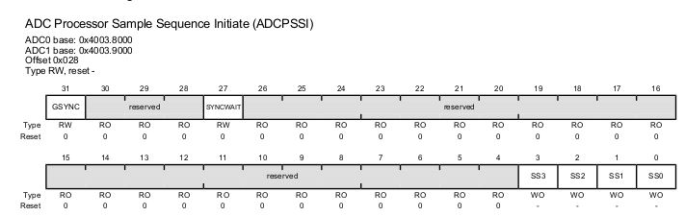
Continue..
After we select the software option bit (which is the default) in the ADCEMUX, we must use bit D3 of ADCPSSI register to start a conversion every time we want a new reading from the ADC input channel.

Slide 13
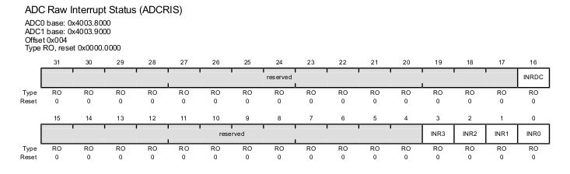
Polling or interrupt
The end-of-conversion is indicated by a flag bit in the ADCRIS (ADC Raw Interrupt) register. Upon the completion of conversion for the SS3, the D3 bit (INR3) flag goes high. By polling this flag, we know if the conversion is complete and we can read the value in ADCSSFIFO3 register. We can also use an interrupt to inform us that the conversion is complete but that will require us to set up the interrupt mask ADCIM. By default, the interrupts are not enabled.

Slide 14
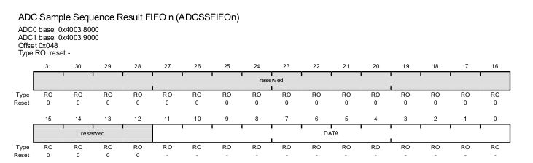
ADC Data result
Upon the completion of conversion, the binary result is placed in the ADCSSFIFOn register. Since we are using SS3, we need to read the result from ADCSSFIFO3 register. This is 32-bit register but only the lower 12 bits are used
.

Slide 15
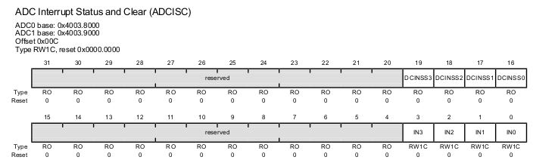
Clearing end-of-conversion flag
After reading the data from the ADCSSFIFOx register, we must clear the INR3 flag bit in ADCRIS register so that we may detect another conversion complete. The raw interrupt flag in ADCRIS is cleared by writing to ADCISC (ADC Interrupt Status and Clear) register. By writing a 1 to bit 3 (IN3 bit) of ADCISC, the interrupt flag is cleared and we can do another conversion again.

Slide 16
Initialization
1.Clock initialization
System Clock(RCGC2)
ADC module Clock(RCGCADC)
Peripheral Clock(PORT E-PIN3)(RCGCGPIO)
2.DC Sample Sequence Input Multiplexer Select n (ADCSSMUXn)
3. Select sample sequencer and trigger(ADCEMUX)
4. Priority Register (ADCSSPRI)
5. Configure ADCSSCTLn Register
6. Enable sequencer(ADCACTSS)
7. Clear the ADC interrupt flag
8.Start Conversion
9.Collect Data

Slide 17
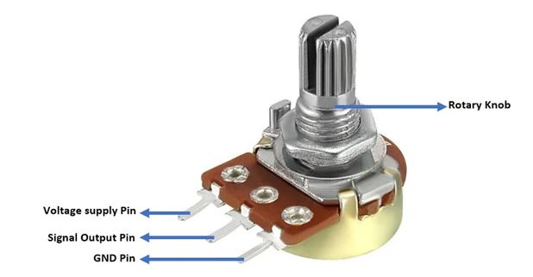
Potentiometer

